Slide 1

Weekly Progress
Team C

Slide 2
Progress Update on Front-End Development
Creates a framework for the basic UI
-Splash page
-Sign Up page
-Verify page
-Log-In page
-Find Password page

Slide 3
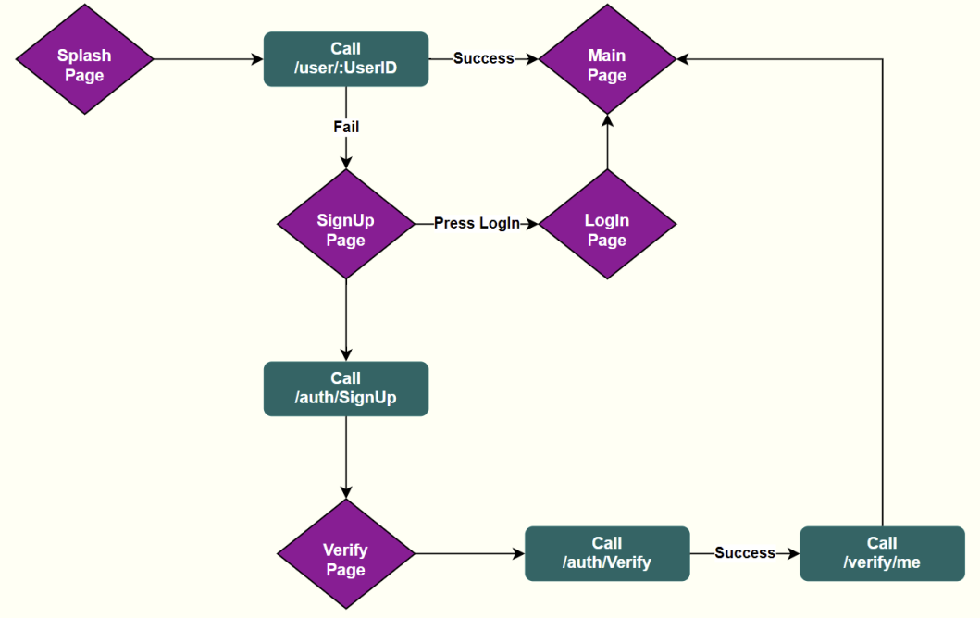
Page Transition Flowchart

Slide 4
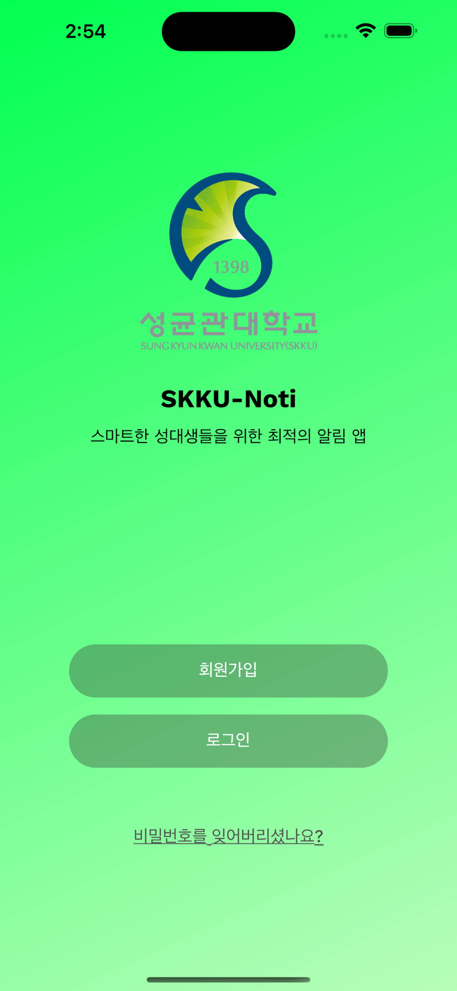
Splash page

Slide 5
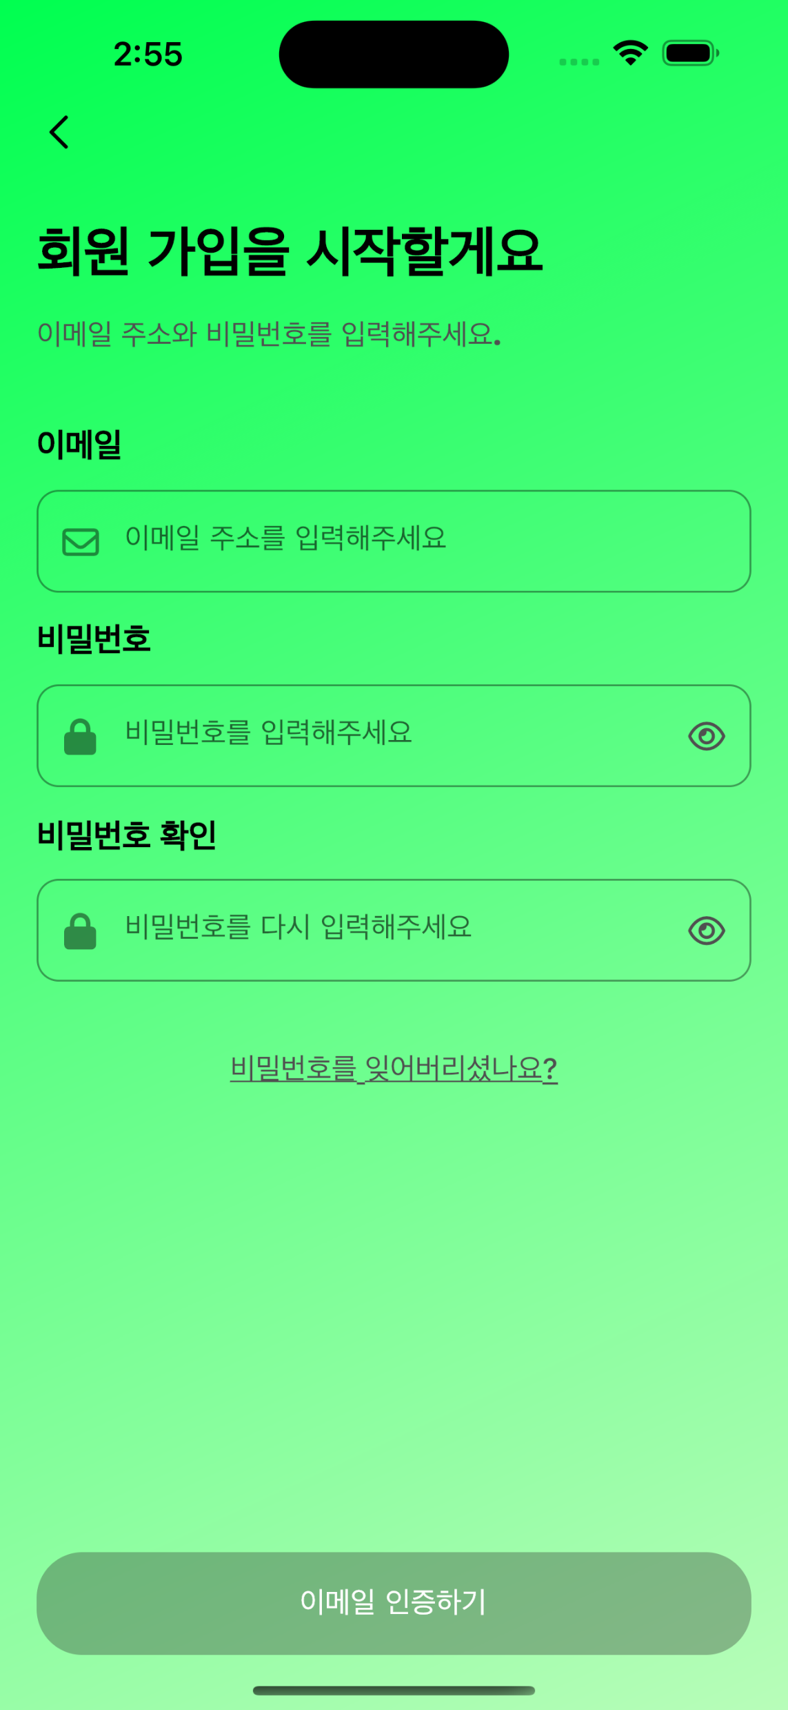
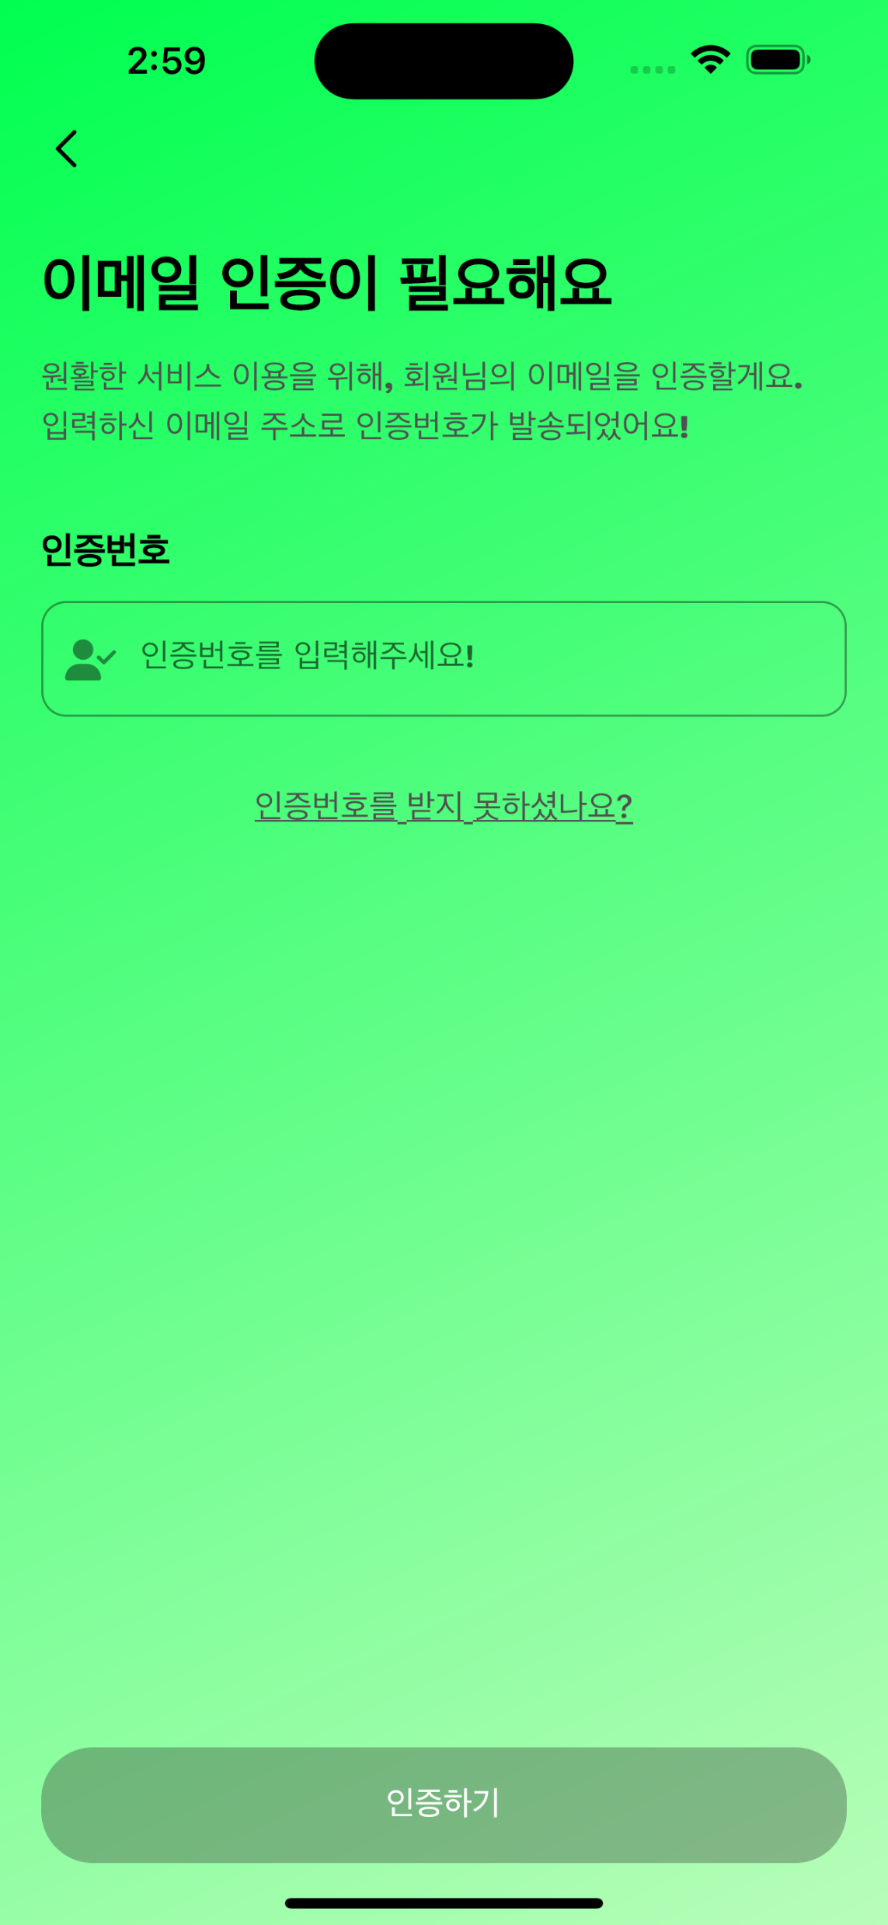
Sign Up and Verify page

Slide 6
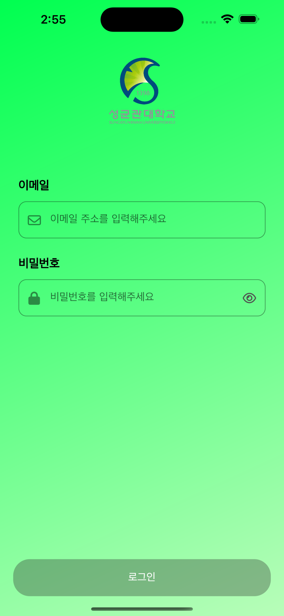
Log-In page

Slide 7
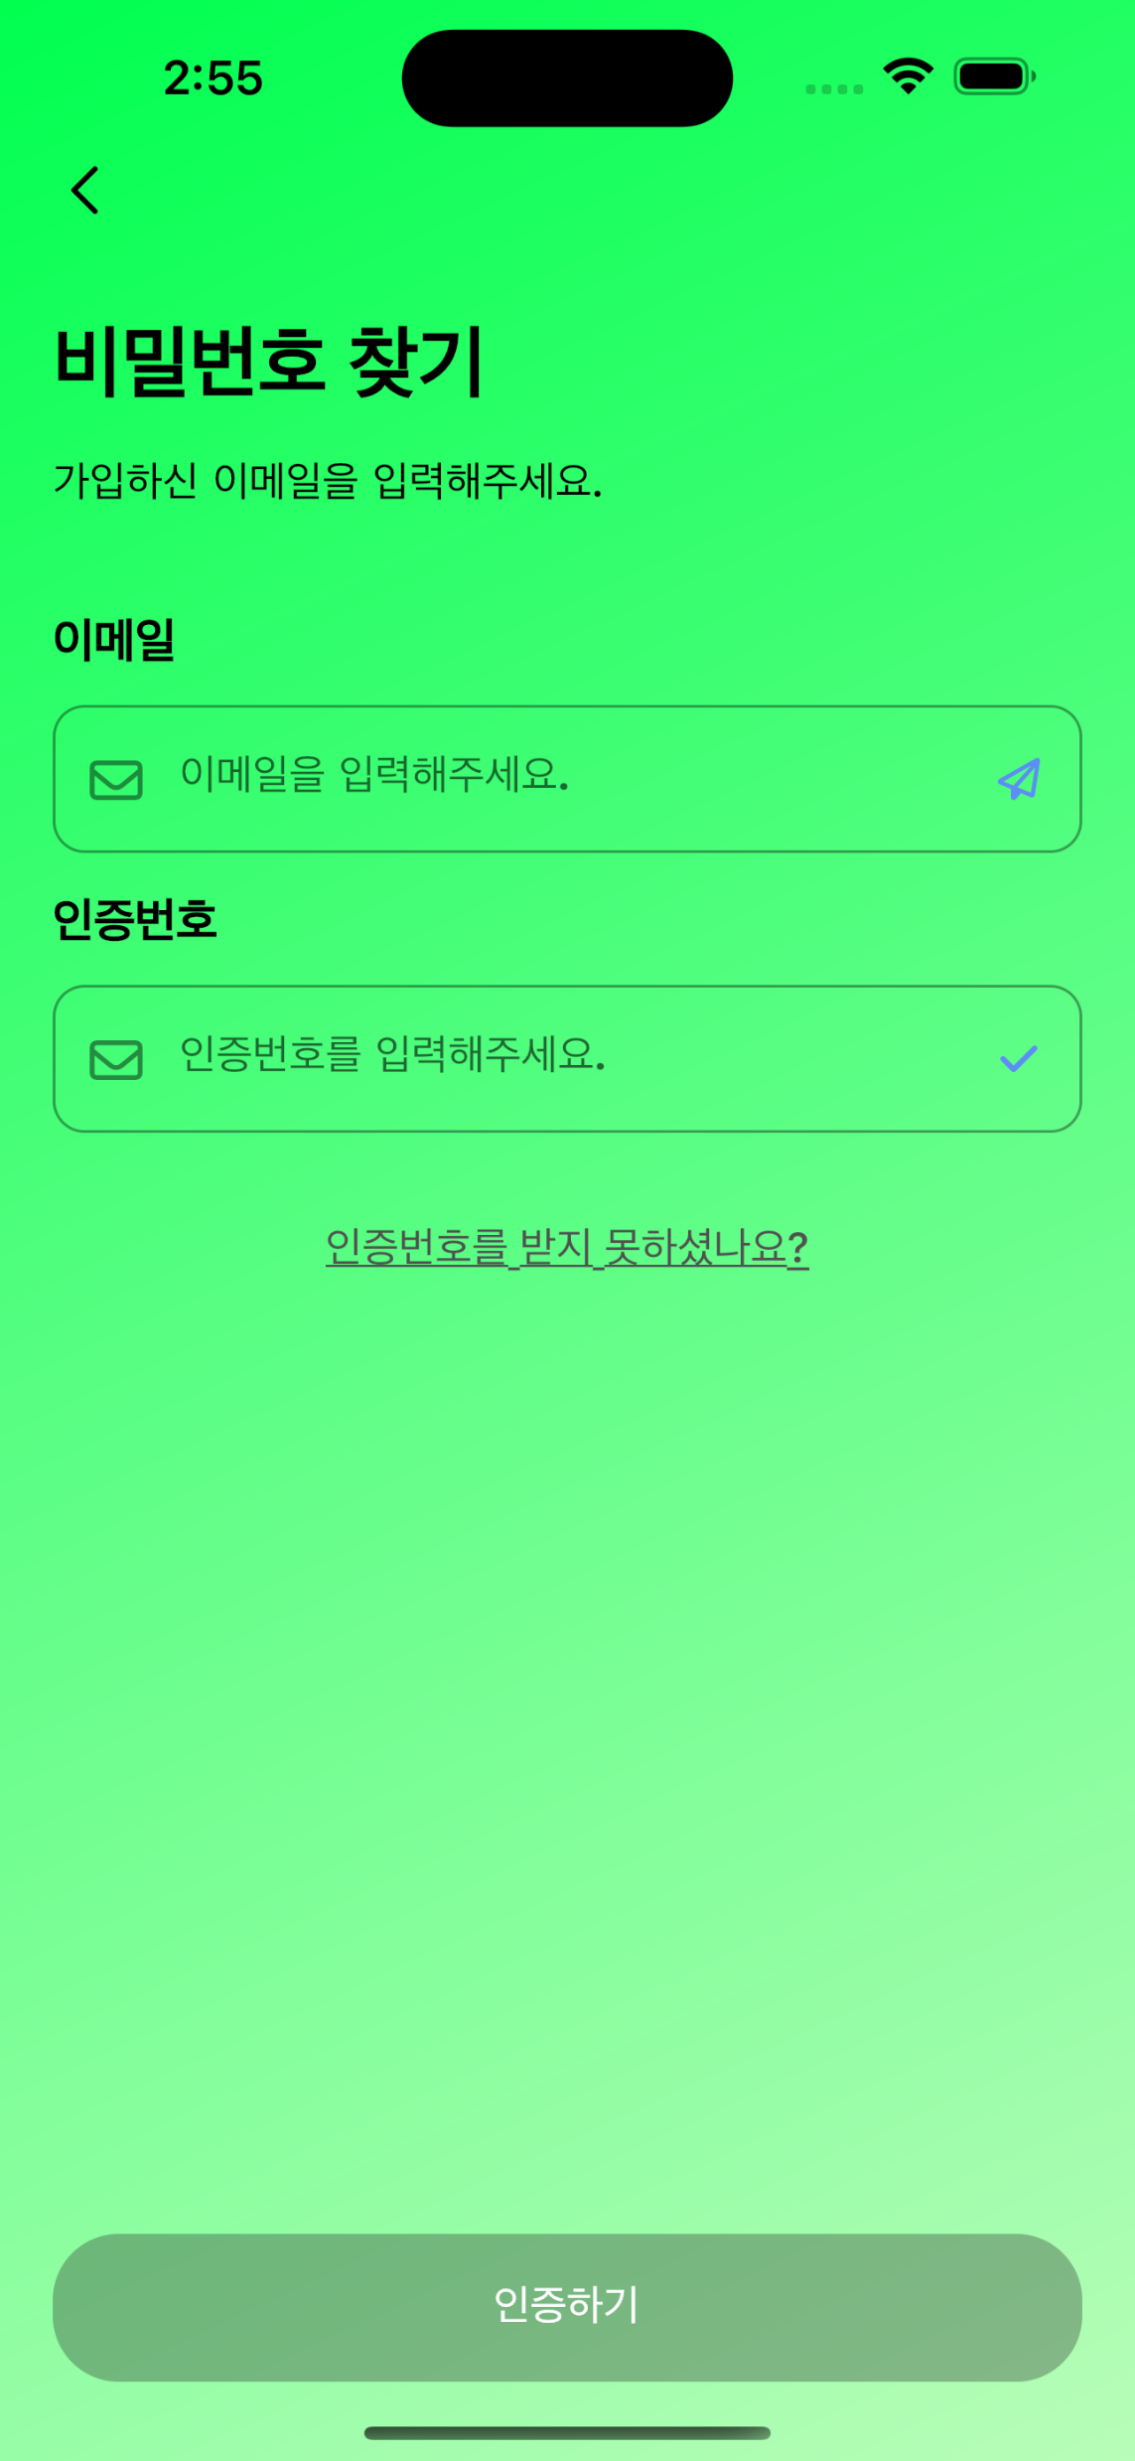
Find Password page

Slide 8
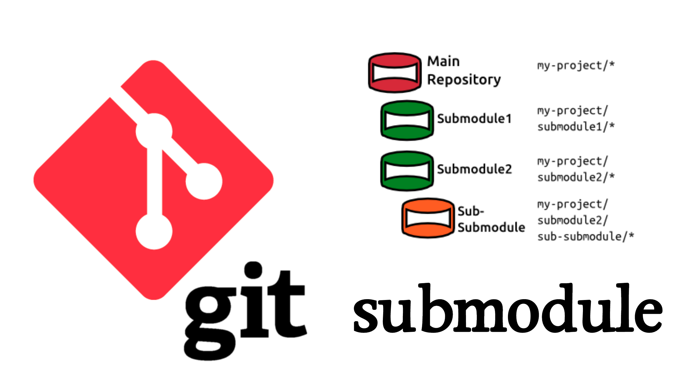
Git Submodule
The submodule of the git is a tool for managing other sub-git parts under the git partitions.

Slide 9
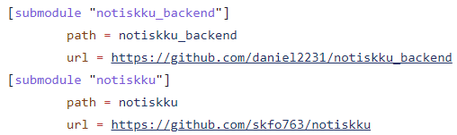
Git Submodule
We added a submodule and added a submodule to .gitmodules as above.

Slide 10
Git Submodule
Modularization and Separation
Independent Version Control
Collaboration and Independence
External Dependency Management

Slide 11
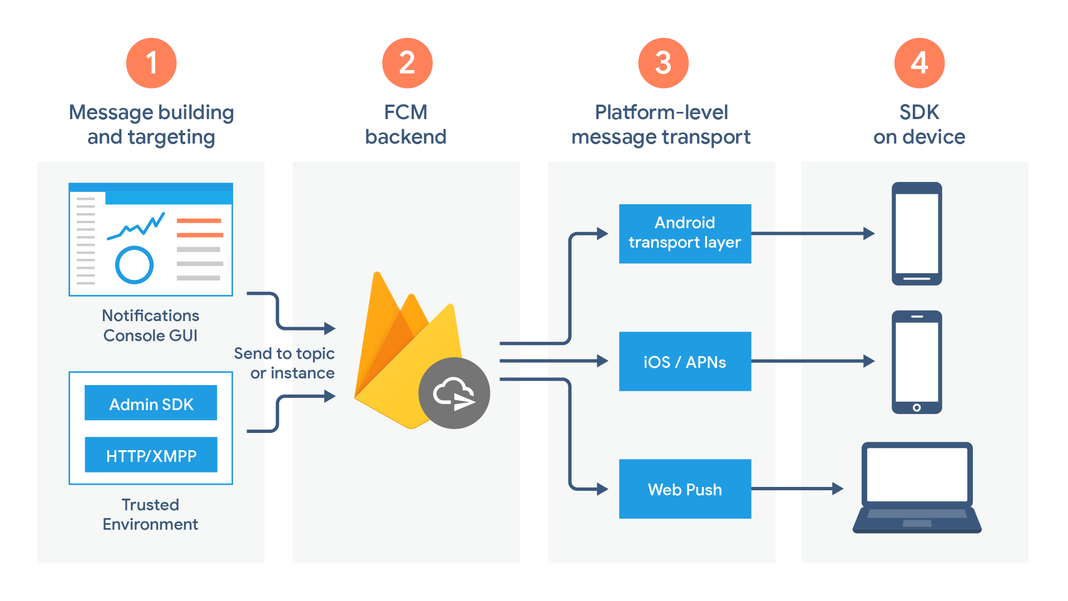
FCM(Firebase Cloud Message)

Slide 12
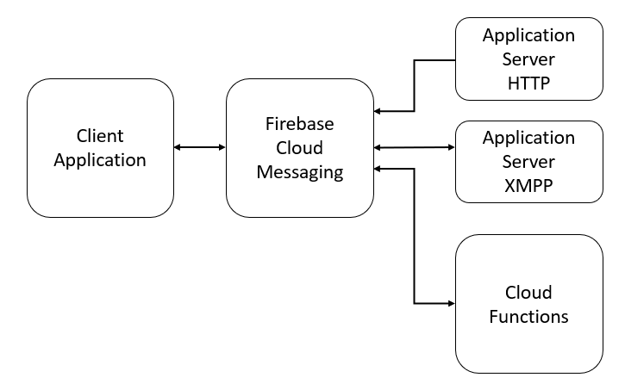
FCM(Firebase Cloud Message)
The FCM Architecture includes three components:
FCM connection server, a Trusted environment with an application server based on HTTP or XMPP and cloud functionality, and a Client application.

Slide 13
Without FCM
Complexity
Limitations in
Real-time Capability
Challenges in
Multi-platform Support
Scalability and Reliability Limitations
Feature Limitations and Update Management

Slide 14
NEXT WEEK

Slide 15
Next Week
-Implement Main Page
-Link page to the server
-Additional UI modifications

